Slide 1
CheapBFT
Lakhveer Kaur

Slide 2
Introduction
Another BFT protocol
Focuses on resource-efficient System
Consist three subprotocols
CheapTiny, CheapSwitch, MinBFT
Depends upon CASH subsystem
Notes:
CheapBFT is a Byzantine Fault Tolerance which focuses on resource efficient system. Before, cheapBFT, several researchers had been done to improve the performance of BFT ; the number of required replicas have been reduced. Despite all the researches, industry was hesitating to actually exploit the research because of high resource demand. So, the aim of cheapBFT was to build resource-eficient BFT system.
CheapBFT is the first BFT protocol to require only f+1 active replicas where f being the number of faulty nodes. Key word here is active. We will go over this in next slides.
The agreement protocol of cheapBFT consist of three subprotocols, namely cheapTiny, cheapSwitch, and MinBFT. cheapTiny is the default protocol. Only f+1 active replicas are selected. All the other replicas go in a passive mode and don’t participate in deciding and executing client requests. This is the technique to save resources. If there is any faulty node suspected, CheapSwitch comes in play. It switches the protocol from cheapTiny to MinBFT. MinBFT involve 2f+1 active replicas. Eventually, system again switches back to cheapTiny.
CASH is a subsystem, that all replicas use. It is used for message authentication and verification. It helps prevent equivocation.
Equivocation: Ability of a replica to make conflicting statment.

Slide 3
CASH Subsystem
Two Basic Functions:
Create Message Certificate
Check Message Certificate
MC uses:
Local counter
Subsystem ID
Keep track of all other CASH counters
May fail only by crashing
Notes:
Before jumping to the actual protocol, let’s see how CASH system actually work
Create a diagram on board
Cash system bounds a counter value to every message that it recevies
To communicate with each other, replicas exchange message certificates. Message Certificate is a cryptographically protected proof, that tells a certain CASH has bound a unique counter value to a message.
Basic version of CASH system provides two functions: Create Message Certificate and Check Message Certificate. (Remember, because of CASH, system is able to reduce the active replicas to f + 1???)
=====================================================================================
To create message certificate: CASH takes local subsystem ID, hash of message, and counter value to create Message Certificate.
CASH securely assigns a unique counter value to each message and guarantees that it will never bind the same counter value to a different message.
To check the message certificate, it checks there is no gap in the sequence message of subsystem
Every subsystem keep track of the counters in all subsystems.
CASH system can fail only by crashing
=====================================================================================
At first, replica calculates a hash of the message. Then it pases hash to the CASH.
Cash #1 produces MAC ID using a private key. Then it creates a message certificate using message authentication code, local subsystem ID and local counter to create a Message Certificate.
To check Message Certificate, CASH verifies certificates MAC, and check there is no gap in sequence message of subsystem.
Each cash keep track of all the latest counter value of all subsystem.
CASH system can fail only by crashing
===========================================================================

Slide 4






Slide 5
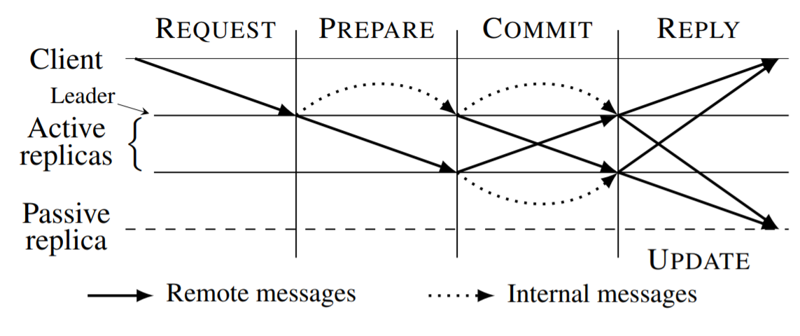
CheapTiny Protocol
Notes:
Cheap Tiny is a default protocol in cheapBFT and behaves similar to some other BFTs.
There are only f+1 replicas participate. Other replicas stay in passive mode.
Each replica has a unique ID. From active replicas, one with the lowest ID becomes the leader.
After getting the message from client, leader’s cash system verify the aunthenicty of message and generates a message certifice.
Then it sends the message <PREPARE, m, mcL> to all active replicas
When a replica, receives the PREPARE, it asks its local CASH to verify that the message certificate is valid, and ‘PREPARE’ is the next message sent by leader using counter. Local CASH generates a MC_L
Then replica sends <COMMIT, m, mcL, mcP> to all active replicas. “Note here the keyword ACTIVE” Passive replicas those are not chosen, don't participate until decision is made
When an active replica receives COMMIT, it verifies the message certificate mc_P is valid. As soon as a replica receives the f+1 valid COMMITS for the sme message m, the request is committed and replica forwards ‘m’ to the execution stage.
To process the request, application provides two objects: reply ‘r’ for the client and state update ‘u’ (caused by execution of m). Each replica’s CASH system, updates message certificate, for the concatenation of ‘r’, ‘u’ and set of COMMITS C confirming that m has been committed.
Active replicas sends an <UPDATE, ‘r’, ‘u’, C, uc_p> to passive replicas. Also sends reply to client with its local ID number.
‘r’: reply for client
‘u’: State update
‘C’: set of Commits
uc_P: updated certificate
Passive replicas confirms updates certificate is correct, counter value does not have any gap, and receicved f+1 matching UPDATEs, replica adjust its update state

Slide 6

CheapSwitch Protocol
Any node can request protocol switch
PANIC message is sent to all replicas
Replicas broadcast the message
Nodes wait for Abort History message
Notes:
Cheap Tiny is optimized to save resources. If there is suspected or faulty node, cheapBFT falls back to MinBFT protocol, whcih relies on 2f+1 active replicas. cheapSwitch is the transition protocol.
All nodes are eligibel to request the abortion of cheapTiny
Client asks for protocol switch if active replicas could not provide f + 1 matching replicas to a request within certain time
Replicas demands abortion, if other replica is not acting according to the expectation (sending false message certificates)
Node sends <PANIC> message to all active and passive replicas.
Replicas rebroadcast the message to ensure that all replicas are notified
Non-faulty active replica stops to send cheaptiny protocol messages and waits for the leader of the new cheapSwitch protocol to distribute abort history.

Slide 7
Abort History
Three Categories:
Decided
Potentially Decided
Undecide
New Leader creates a history using:
All the messages after last checkpoint
Message agreement certificates
Message updated certificates
Other Replicas check all three values and send switch
One replica sends PANIC and all can verify

Slide 8
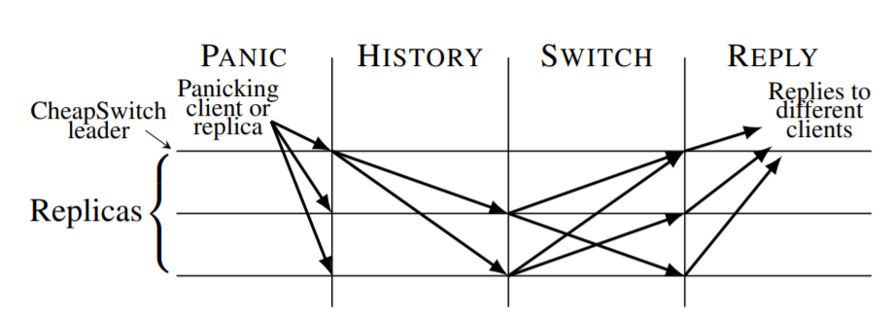
Cheap Switch Protocol
Notes:
Creating an Abort History:
Decided: Client request has been committed prior to abortion protocol. Leader provides the set of f+1 commits in the HISTORY
Potentially decided: Leader has a valid PREPARE and has sent out COMMIT. So, COMMIT might have been committed on some of replicas. So, leader includes its own COMMIT in history
Undecided: Leader has not send out the COMMIT mesage (prior steps might have been taken) Leader includes the request in the abort HISTORY
Leader’s CASH creates two certificate hcL_ag, hcL_up.
Leader sends <HISTORY h, hcL_ag, hcL_up> to all replicas. (hcL_ag is counter in agreement stage and hc_ag is the updated counter)
History of all messages after a certain checkpoint
Validating an Abort History:
Check both certificates
Can verify that the latest checkpoints are stable
Abort history is issued by one replica and other replicas are able to verify its correctness independently
Replica checks that the abort history proves the complete sequence of messages sent by leader since the latest checkpoint.
After verifying that an abort history is correct, a replica sends a SWITCH to all other replicas.
After reciving ‘f’ matchign switch messages, history become stable.
If abort history does not become stable after certain time, leader is suspected to be faulty and a new instance of CheapSwitch is started with next smallest ID replica.
FROM PAPER: when history P1 and P2 are different. The order of messages must be same (by CASH system). Bt P1’s history can contain the messages that are not contained in P2’s history. (because one had received commit and other has not by the time system switched to SWITCH protocol).

Slide 9
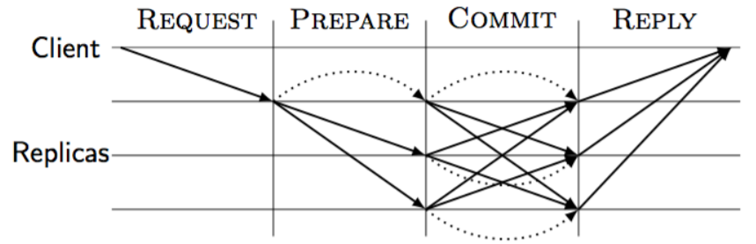
MinBFT Protocol
Notes:
All 2f+1 replicas comes in play. After some predefined number of agreement rounds, system switches back to the MinBFT since faulty replicas are not gonna remain faulty for forever. This protocol works exactly like cheapTint but just requires 2f + 1replicas (All replcias to be active)

Slide 10
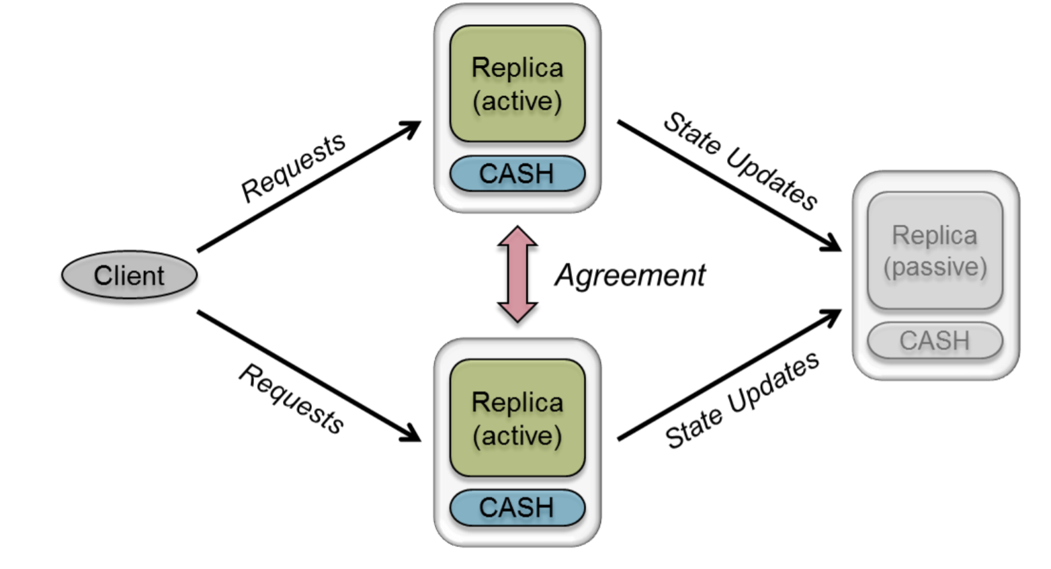
Resource Efficient
Notes:
ChapBFT uses all the ways that other BFT system uses for optimization. The one that is the center of this protocol is to have passive replicas. It not only minimize the number of executions but also decrese the number of messages that needs to be communicated
Passive replicas neither agree on requests nor execute the requests. They just change their state by getting f+1 valid state undates requests.

Slide 11
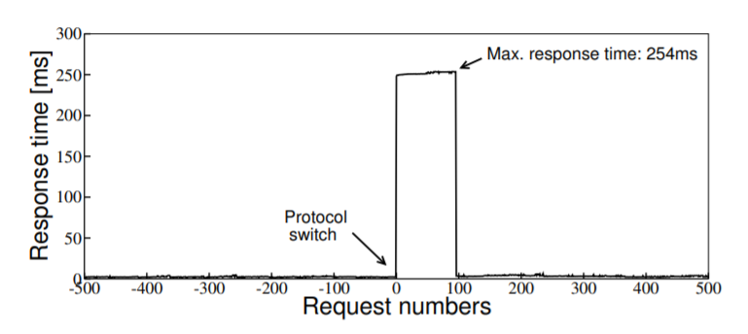
Switch Time CheapTiny to MinBFT
Notes:
Micro Benchmark run with 100 clients
Checkpoint interval is set to 200 requests
Figure 13 shows the response times of 1,000 requests handled by CheapBFT around the time the replicas run the CheapSwitch transition protocol.
While verifying and processing the abort history, replicas are not able to execute requests, which leads to a temporary service disruption of max. 254 milliseconds. After the protocol switch is complete, the response times drop back to the normal level for MinBFT.

Slide 12
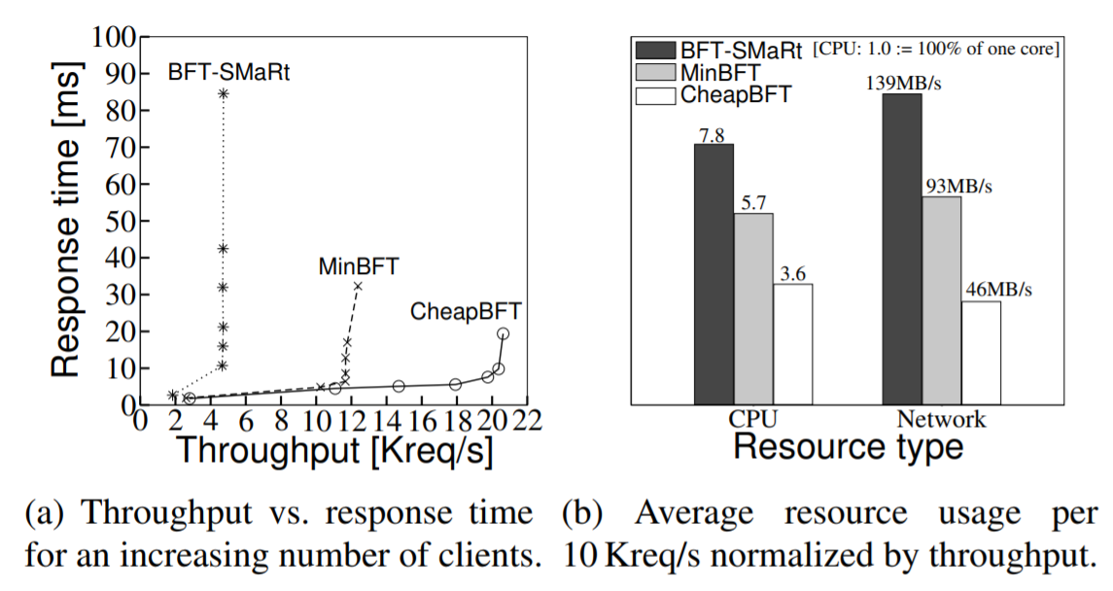
Performance with 4KB Request & Empty Replies
Notes:
Empty requests and 4kbite replies
Beside performance, also evaluate the CPU and network usage of BFT-Smart, MinBFT and CHeapBFT. In order to comare it directly, we aggregate the resource consumption of all replicas in a system and normalize the respective value at maximum throughput to a throughput of 10,000 request per second.
For such a workload, transmitting requests to active replicas is the decisive factor influencing both performance and resource consumption. CheapBFT replicas need to send 67% less data over the network compare to BFT-Smart. (about 50% less data compare to MinBFT) and 54% less CPU than BFT Smart and 37% less than CPU minBFT

Slide 13
Thank You!

Slide 14
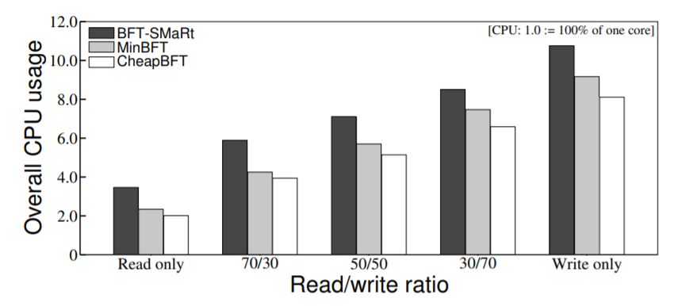
CPU usage per 10 Kreq/s normalized by throughput.

